Slide 1
Constrained Kmeans clustering algorithms for LCC

Slide 2
Implications
COP-Kmeans algorithm (Wagstaff, Cardie, Rogers, & Schrödl, 2001)
BCOP-Kmeans (BCKM) algorithm (Okabe & Yamada, 2018)
Pros:
Multiple implementations exist
Faster than others (O(nk+n^2))
Extended to consider cluster-level constraints (course constraints)
Cons:
Individual preferences are considered as hard constraints which doesn’t meet the LCC requirements (informal description)
A single violation of must-link (ML) or cannot-link (CL) aborts the algorithm
Performs worse than others (no comparison done by author)
Pros:
Evaluates ML and CL constraints as soft constraints.
Doesn’t abort even a connection (ML or CL) is violated
Performs better than others (compared to COP-Kmeans, not compared to SCOP-Kmeans by author)
Cons:
No implementation found on the web and no response from author so far regarding the implementation
Slightly slower than others (compared to COP-Kmeans, not compared to SCOP-Kmeans by author)
Doesn’t consider cluster-level constraints, no other version has been developed by authors for cluster-level constraints
Hasn’t been extended to consider course constraints
SCOP-Kmeans algorithm (Wagstaff K. L., 2002)
Pros:
Able to consider hard and soft constraints (meets LCC requirements)
Extended to consider cluster-level constraints (course constraints)
Aborts only when a course constraint cannot be satisfied
Performs better than COP-Kmeans (no comparison done by author)
Cons:
No implementation found and no response from author so far
Slower than COP-KMeans
Performs worse than BCOP-Kmeans (no comparison done by author)
S as “Soft” in SCOP
B as “Boosted” in BCOP (BCKM)

Slide 3
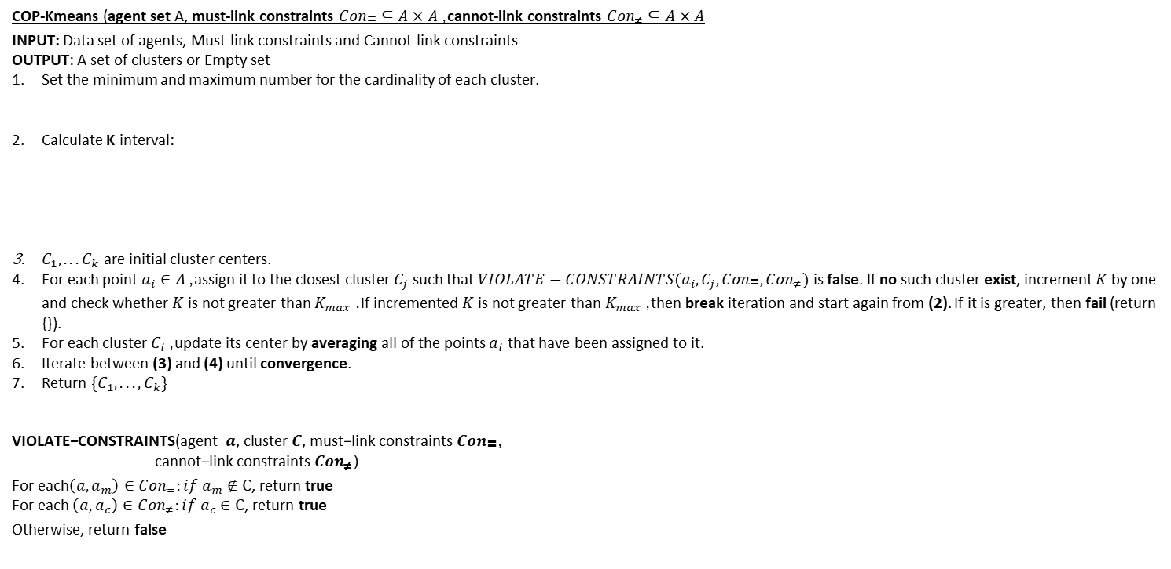
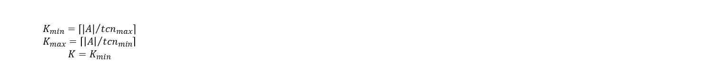
COP-KMeans algorithm (Wagstaff, Cardie, Rogers, & Schrödl, 2001)
COP-Kmeans (agent set A, must-link constraints ${Con}_{\text{=}}⊆A×A$, cannot-link constraints ${Con}_{\text{≠}}⊆A×A$
INPUT: Data set of agents, Must-link constraints and Cannot-link constraints
OUTPUT: A set of clusters or Empty set
Set the minimum and maximum number for the cardinality of each cluster.
Calculate K interval:
$C_{1},...C_{k}$ are initial cluster centers.
For each point $a_{i}∈A$, assign it to the closest cluster $C_{j}$ such that $VIOLATE−CONSTRAINTS(a_{i},C_{j},{Con}_{\text{=}},{Con}_{\text{≠}})$ is false. If no such cluster exist, increment $K$ by one and check whether $K$ is not greater than $K_{max}$. If incremented $K$ is not greater than $K_{max}$, then break iteration and start again from (2). If it is greater, then fail (return {}).
For each cluster${ C}_{i}$, update its center by averaging all of the points $a_{i}$ that have been assigned to it.
Iterate between (3) and (4) until convergence.
Return $\{C_{1},...,C_{k}\}$
$\begin{aligned}\text{VIOLATE}\text{−}\text{CONSTRAINTS}\text{(}\text{agent} a\text{, }\text{cluster} C\text{, }\text{must}\text{−}\text{link} \text{constraints} {Con}_{\text{=}}\text{,} \\ \text{cannot}\text{−}\text{link} \text{constraints} {Con}_{\text{≠}}\text{)}\end{aligned}$
For each$\left(a, a_{m}\right)∈Con_{=}:if a_{m}∉C$, return true
For each $\left(a, a_{c}\right)∈Con_{\text{≠}}:if a_{c}∈C$, return true
Otherwise, return false
$${tcn}_{min}=2,{tcn}_{max}=5$$
$$\begin{aligned}K_{min}=⌈{|A|}/{{tcn}_{max}}⌉ \\ K_{max}=\left\lceil {\left|A\right|}/{{tcn}_{min}}\right\rceil \\ K=K_{min}\end{aligned}$$

Slide 4
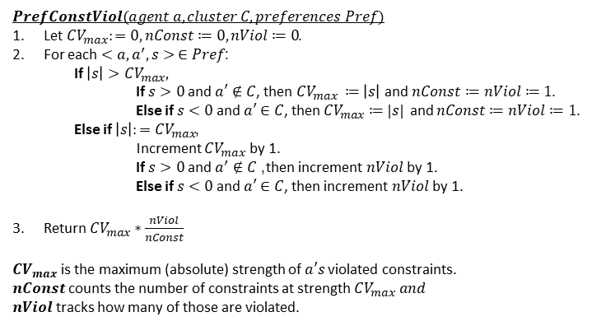
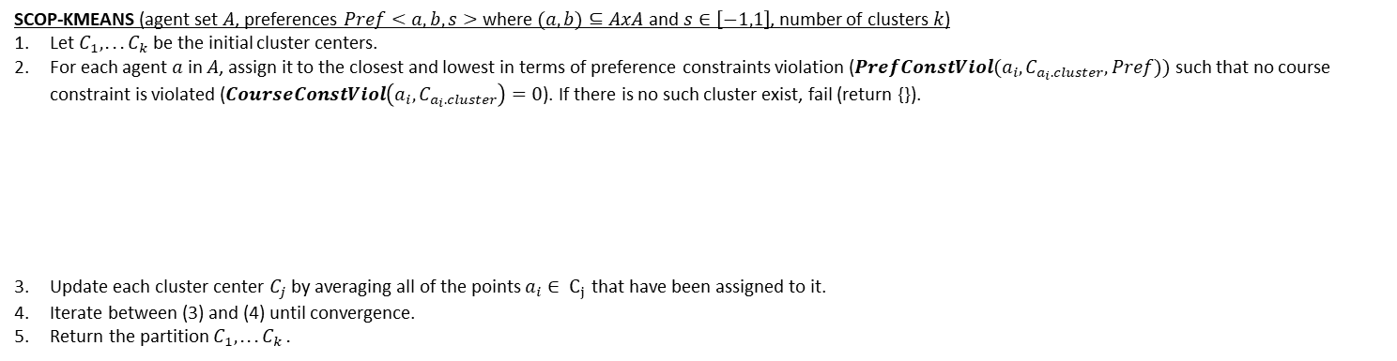
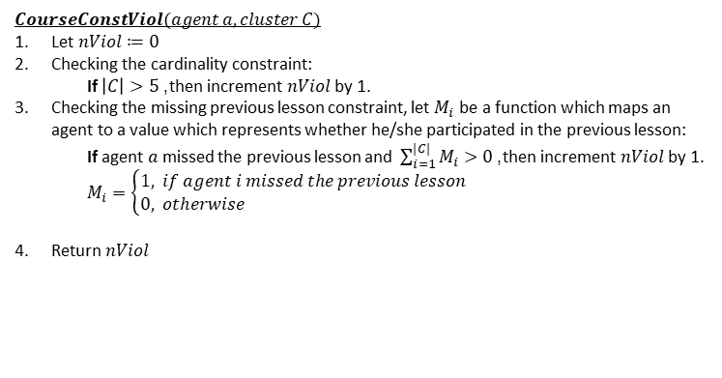
SCOP-KMeans algorithm (Wagstaff K. L., 2002)
SCOP-KMEANS (agent set $A$, preferences $Pref<a,b,s>$ where $(a,b)⊆AxA$ and $s∈\left[−1,1\right]$, number of clusters $k$)
Let $C_{1},...C_{k}$ be the initial cluster centers.
For each agent $a$ in $A$, assign it to the closest and lowest in terms of preference constraints violation ($PrefConstViol(a_{i},C_{a_{i}.cluster},Pref))$ such that no course constraint is violated ($CourseConstViol\left(a_{i},C_{a_{i}.cluster}\right)=0$). If there is no such cluster exist, fail (return {}).
Update each cluster center $C_{j}$ by averaging all of the points $a_{i}∈ C_{j}$ that have been assigned to it.
Iterate between (3) and (4) until convergence.
Return the partition $C_{1},...C_{k}$.
$minimize\sum_{i=1}^{|A|}{ \frac{dist\left(a_{i},C_{a_{i}.cluster}\right)}{r}+ PrefConstVi{ol}_{ }(a_{i},C_{a_{i}.cluster},Pref)}$
$subject to \sum_{i=1}^{|A|}{CourseConstViol(a_{i},C_{a_{i}.cluster})}=0$
${where C}_{a_{i}.cluster }∈\left\{C_{1}, . . . C_{k}\right\}, r=100 and it is used to equalize the scales$
$dist(a,C)∈[0,100]$, $PrefConstViol(a,C,Pref)∈[0,1]$, $CourseConstViol(a,C)∈[0,2]$
$PrefConstViol(agent a, cluster C, preferences Pref)$
Let $CV_{max}:=0, nConst≔0, nViol≔0$.
For each $<a,a^{′},s> ∈Pref$:
If $\left|s\right|>CV_{max},$
If $s>0$ and $a′∉C$, then $CV_{max }≔\left|s\right|$ and $nConst≔nViol≔1$.
Else if $s<0$ and $a′∈C$, then $CV_{max}≔|s|$ and $nConst≔nViol≔1$.
Else if $\left|s\right|:=CV_{max}$,
Increment $CV_{max}$ by 1.
If $s>0$ and $a^{′}∉C$, then increment $nViol$ by 1.
Else if $s<0$ and $a′∈C$, then increment $nViol$ by 1.
Return $CV_{max}∗\frac{nViol}{nConst}$
$CV_{max}$ is the maximum (absolute) strength of $a′s$ violated constraints.
$nConst$ counts the number of constraints at strength $CV_{max} and$ $nViol$ tracks how many of those are violated.
$CourseConstViol(agent a, cluster C)$
Let $nViol≔0$
Checking the cardinality constraint:
If $\left|C\right|>5$, then increment $nViol$ by 1.
Checking the missing previous lesson constraint, let $M_{i}$ be a function which maps an agent to a value which represents whether he/she participated in the previous lesson:
If agent $a$ missed the previous lesson and $\sum_{i=1}^{|C|}{M_{i}}>0$, then increment $nViol$ by 1.
$M_{i}=\left\{\begin{aligned}1, &if agent i missed the previous lesson \\ 0, &otherwise\end{aligned}\right.$
Return $nViol$

Slide 5
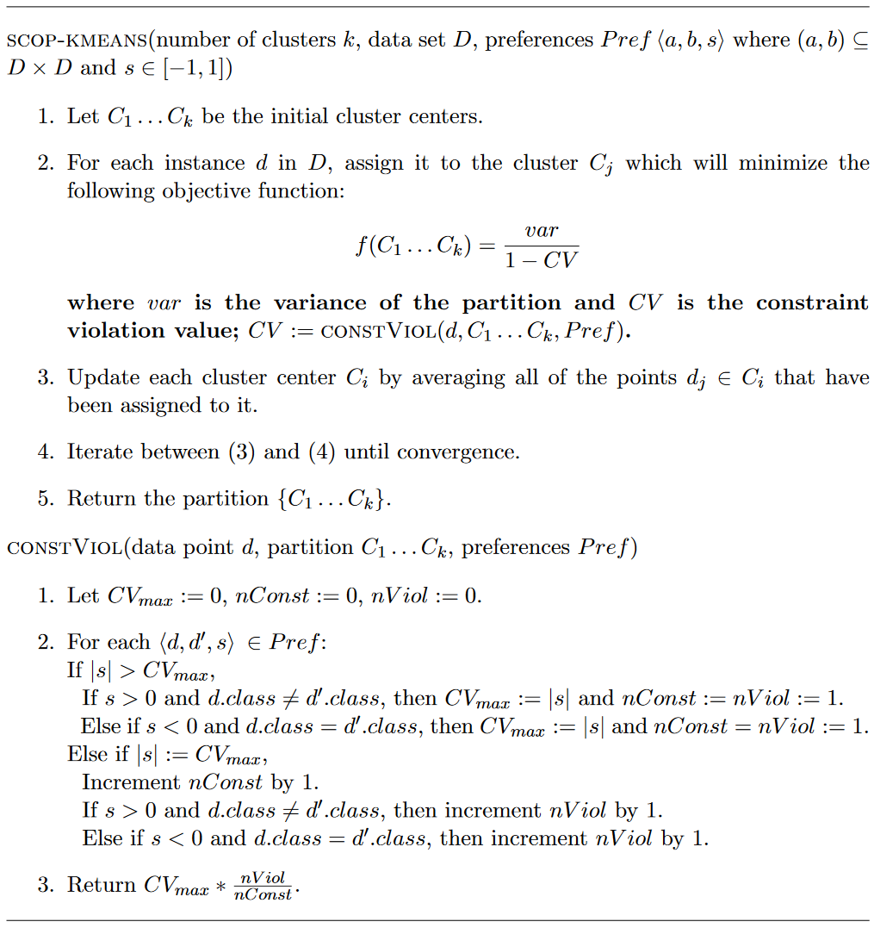
SCOP-KMeans algorithm by Kiri Wagstaff (Wagstaff K. L., 2002)

Slide 6
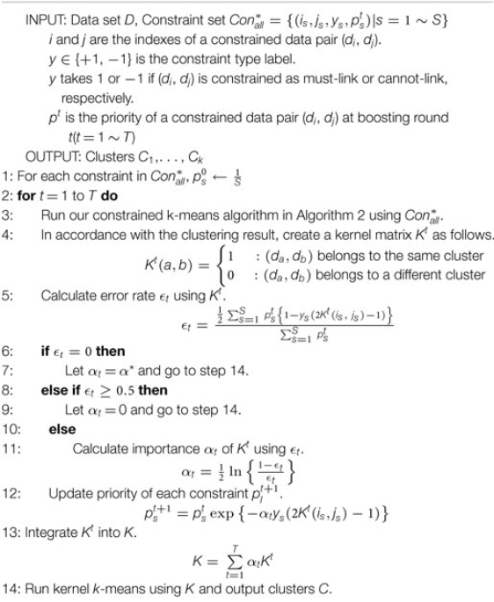
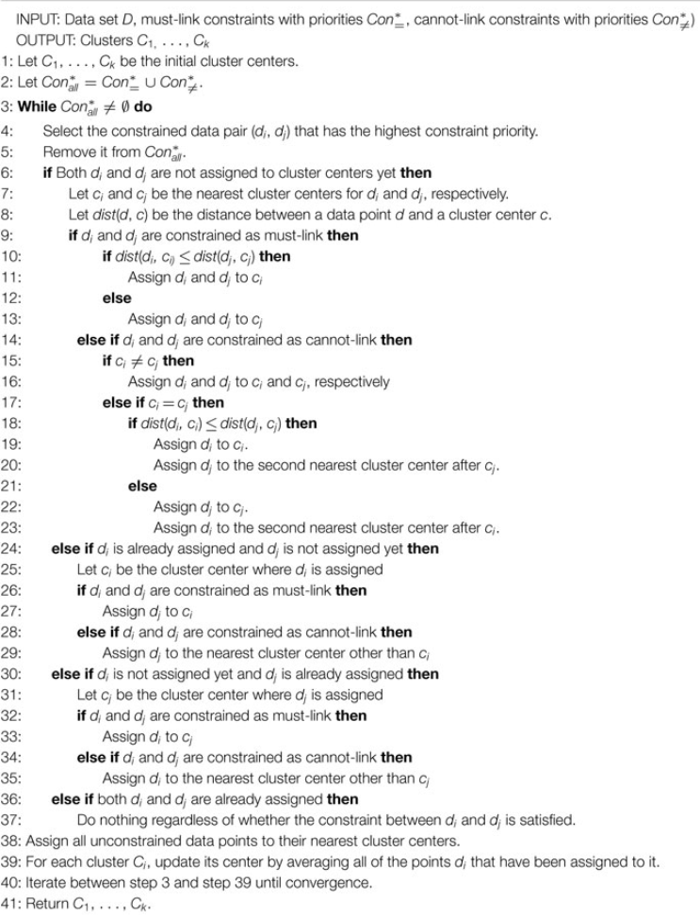
BCOP-Kmeans (BCKM) algorithm (Okabe & Yamada, 2018)

Slide 7
LCC_SCOP-Kmeans Solution Protocol

Slide 8
App-Agent communication: Submitting and saving exercise result
MyWelcome app#1
MyWelcome app#m
App-Logic
. . .
App-Logic
Steps:
App-logic sends the exercise results to agent
Agent calculates the course progress level (CPL) by averaging all of the lesson progress levels that were submitted so far.
Agent saves the CPL and submitted scores.
App-Logic
App-Logic
App-Logic Interface
App-Logic Interface
1.1 Send scores to agent#1
1.m Send scores to agent#m
Info package: Reading: …
Writing : …
Grammar : …
Vocabulary : …
Lesson Progress Level : …
Info package: Reading: …
Writing : …
Grammar : …
Vocabulary : …
Lesson Progress Level : …
Agent#1
Agent#m
2.1 Compute Course Progress Level
. . .
2.m Compute Course Progress Level (CPL)
Agent Interface
Agent Interface
LAKR#1
3.1 Save CPL and scores to LAKR
LAKR#1
3.m Save CPL and scores to LAKR

Slide 9
LCC Protocol: Teacher requests grouping proposal
Phase 1.a Teacher selects a list of agents who belong to the same classroom
WPM
Teacher Panel
Info package
Agents:
Agent_1 - active, *cl3
.
Agent_10 - active, cl3
Agent_11 - inactive, cl3
.
Agent_m - inactive. cl3
Phase 1.c.1
Form groups
Phase 1.c.m
Form groups
Phase 1.b. WPM reactivates inactive agents
Info package Form groups with:
*Agent_1,
.
Agent_m
Info package Form groups with:
*Agent_1,
.
Agent_m
WPM Interface
Info package
Agents:
Agent_11,
.
Agent_m
WAR
Agent#1
Agent#m
Agent#n
. . .
. . .
Agent Interface
Agent Interface
Agent Interface
Steps:
Phase 1.a Teacher selects a list of TCNs who belong to the same classroom, via Teacher panel in WPM
Phase 1.b WPM reactivates inactive agents of TCNs such that all agents in the list are active before next step.
Phase 1.c WPM selects (randomly or based on resource availability of the agent) an agent as dedicated agent. WPM attaches dedicated agent and list of agents information to a signal and sends it to each agent to inform them to start coordination.
Communication:
Phase 1.c - m
*Agent_1: indicates that agent_1 is selected as dedicated agent
*cl3: is classroom name - classroom 3

Slide 10
LCC Protocol : Agents share info
Received signal to start coordination
Agent#1
Phase 2.a.10 Send info to dedicated agent
Phase 2.a.m Send info to dedicated agent
Not received any signal
to start coordination
Agent Interface
Phase 2.b Collection of personal info (no preference) from agents
Phase 2.d Generate individual constraints (IC) set based on individual preferences
Agent#n
Info package:
Gender: …
Nationality: …
CPL: …
Attendance:…
Phase 2.e.10 Send IC to dedicated agent
Phase 2.e.m Send IC to dedicated agent
Info package:
Gender: …
Nationality: …
CPL: …
Attendance:…
Received signal to start coordination
Agent Interface
Info package
Individual constraints
Info package
Individual constraints
Received signal to start coordination
Agent#10
Phase 2.c.10 Send complete info to agent#10
. . .
Phase 2.c.m Send complete info to agent#m
Agent#m
Agent Interface
Info package
Agent#1 info
.
Agent#m info
Info package
Agent#1 info
.
Agent#m info
Agent Interface
Phase 2.d Generate individual constraints (IC) set based on individual preferences
Phase 2.d Generate individual constraints (IC) set based on individual preferences
Steps:
Phase 2.a. Each agent receives the signal and sends its personal info to dedicated agent. Agents don’t share their preferences.
Phase 2.b. Dedicated agent collects the necessary info from coordinating agents and builds the complete info of all agents.
Phase 2.c. Dedicated agent broadcasts the complete info to all agents.
Phase 2.d. Since each agent has the complete info, each of them generates a set (IC) of individual constraints based on their individual preferences. To do so, they make use if Individual Preference Evaluation (IPE) function. Detailed info given in the last slides.
Phase 2.e. Each agent sends its IC set to dedicated agent.
Communication:
Phase 2.a - m-1
Phase 2.c – m-1
Phase 2.e – m-1

Slide 11
LCC Protocol : Agents find solution
Collected ML and CL from all agents
Agent#1
Phase 3.b.10 Send the FC to agent#10
Phase 3.b.m Send the FC to agent#m
Not participating in the coordination
Agent Interface
Phase 3.a Build the complete constraints and refine to get final constraints (FC) set
Phase 3.c Since all necessary info is collected, run the SCOP-Kmeans
Agent#n
Agent Interface
Phase 3.d.10 Send the result to agent#10
Phase 3.d.m Send the result to agent#m
Agent#10
Phase 3.d.w Send the result to WPM
Agent#m
Agent Interface
Agent Interface
WPM
Teacher Panel
WPM Interface
Steps:
Phase 3.a. Dedicated agent builds the complete constraints set by combining all individual IC sets which are collected from agents. Then it refines the complete constraints set and get Final Constraints (FC) set. Detailed info is given in the last slides.
Phase 3.b. (Optional) Broadcast the FC to other agents such that they can solve the problem in case dedicated agent is accidentally killed. In this case, WPM signals another agent to become the dedicated agent who must approve that it has the complete ML and CL. Otherwise, it requests all agents to start from phase 2.d again.
Phase 3.c. Since dedicated agent has all the necessary info, it solves the LCC problem by running SCOP-KMeans algorithm (in the last slides) and finds a result.
Phase 3.d. Dedicated agent sends the result to all agents and WPM. (Optional) WPM might decide to request to kill the agents which were involved in the coordination process.
Communication:
Phase 3.b - m-1
Phase 3.d – m

Slide 12
LCC Protocol : Sending final grouping to agents
Teacher received the grouping proposal from agents
Phase 4.a Teacher either
Modifies the proposal
Approves the proposal
WPM
Teacher Panel
Phase 4.c.1 WPM informs agent#1
Phase 4.c.m WPM informs agent#m
Info package:
Send Grouping result only if the teacher modified the proposal
Info package:
Send Grouping result only if the teacher modified the proposal
WPM Interface
Phase 4.b WPM reactivates the inactive agents in the selected grouping
or
or
Info package:
Send Approved only if the teacher approves the proposal
Info package:
Send Approved only if the teacher approves the proposal
Steps:
Phase 4.a. After receiving a proposal, teacher can modify or approve the proposal which is sent by agents.
Phase 4.b. Once the teacher submits/approves, WPM needs to reactivate the inactive agents in the submitted/approved grouping such that all of them can receive the final grouping.
Phase 4.c. WPM informs each agent which is in the final grouping. The signal should contain either the grouping result or “approved”, respectively, depending on whether teacher modifies or approves.
Agent#1
Agent#m
Agent#n
. . .
. . .
Communication:
Phase 4.c - m
Agent Interface
Agent Interface
Agent Interface

Slide 13
LCC Protocol : Informing TCN about his/her group
MyWelcome app#1
MyWelcome app#m
App-Logic
App-Logic
App-Logic
. . .
App-Logic
App-Logic Interface
App-Logic Interface
Phase 5.a.1 Send info to app-logic
Phase 5.a.m Send info to app-logic
Info package: Send the name of group of TCN#1
Info package: Send the name of group of TCN#m
Agent#1
Agent#m
Steps:
Phase 5.a. Once an agent receives the final grouping from WPM (Teacher), it only sends the name of the group of TCN to app-logic. Since agents don’t know the identities of other group members, they send the group name such that TCNs can find each other in the classroom.
Phase 5.b. Agents send coordination_ended signal to WPM.
-* Even if the TCN is logged out when agent sends the group name (at phase 5.a), the agent will still continue to phase 5.b. Since agent stores the group name into LAKR, it is not lost. Therefore, TCN will always be able request it from the agent via app-logic.
. . .
Agent Interface
Agent Interface
Phase 5.b.1 Send coordination ended signal to WPM
Phase 5.b.m Send coordination ended signal to WPM
WPM
Teacher Panel
Communication:
Phase 5.a – m
Phase 5.b – m
WPM Interface

Slide 14
Involved Components and Functionalities to be provided
Agent
MyWelcome app_1
MyWelcome app
MyWelcome app_1
WPM
Dispatcher
App-Logic
Teacher Panel
App-Logic
App-Logic
App-Logic Interface
App-Logic Interface
App-Logic Interface
Agent Interface
Dispatcher Interface
WPM Interface
Teacher panel (doesn’t have to be in WPM)
Teacher panel would be able to receive the proposal from agents.
Receiving coordination_ ended signal
Receive exercise result, calculate and store.
Receive start_coordination signal and share info.
Receive personal info and broadcast to others (dedicated agent).
Receive complete personal info from dedicated agent.
Receive ML and CL from other agents, build and broadcast complete ML and CL.
Solve the LCC, broadcast the result to other agents and share with WPM.
Receive “approved” or grouping from WPM, share with TCN.
Send coordination_ended signal to WPM.
Receive the name of the group of TCN.

Slide 15
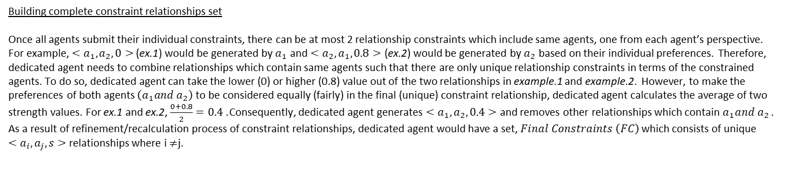
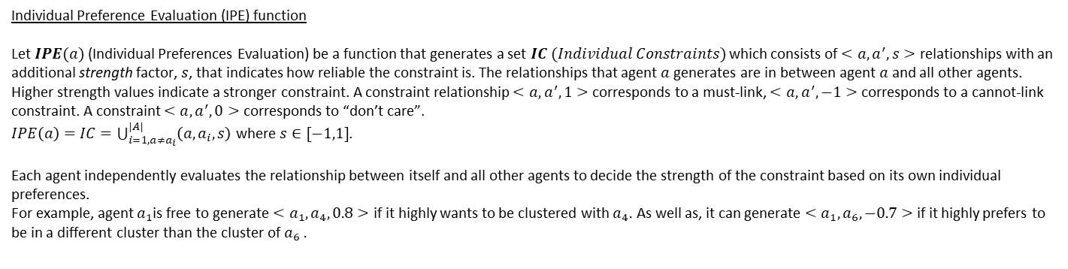
Functions
Individual Preference Evaluation (IPE) function
Let $IPE(a)$ (Individual Preferences Evaluation) be a function that generates a set $IC (Individual Constraints)$ which consists of $<a,a^{′},s>$ relationships with an additional strength factor, $s$, that indicates how reliable the constraint is. The relationships that agent $a$ generates are in between agent $a$ and all other agents. Higher strength values indicate a stronger constraint. A constraint relationship $<a,a^{′},1>$ corresponds to a must-link, $<a,a^{′},−1>$ corresponds to a cannot-link constraint. A constraint $<a,a^{′},0>$ corresponds to “don’t care”.
$IPE\left(a\right)=IC=\bigcup_{i=1, a≠a_{i}}^{|A|}{\left(a,a_{i},s\right)}$ where $s∈[−1,1]$.
Each agent independently evaluates the relationship between itself and all other agents to decide the strength of the constraint based on its own individual preferences.
For example, agent $a_{1}$is free to generate $<a_{1}, a_{4}, 0.8>$ if it highly wants to be clustered with $a_{4}.$ As well as, it can generate $<a_{1},a_{6},−0.7>$ if it highly prefers to be in a different cluster than the cluster of $a_{6}$.
Building complete constraint relationships set
Once all agents submit their individual constraints, there can be at most 2 relationship constraints which include same agents, one from each agent’s perspective. For example, $<a_{1},a_{2},0>$ (ex.1) would be generated by $a_{1}$ and $<a_{2},a_{1},0.8>$ (ex.2) would be generated by $a_{2}$ based on their individual preferences. Therefore, dedicated agent needs to combine relationships which contain same agents such that there are only unique relationship constraints in terms of the constrained agents. To do so, dedicated agent can take the lower (0) or higher (0.8) value out of the two relationships in example.1 and example.2. However, to make the preferences of both agents $\left(a_{1}and a_{2}\right)$ to be considered equally (fairly) in the final (unique) constraint relationship, dedicated agent calculates the average of two strength values. For ex.1 and ex.2, $\frac{0+0.8}{2}=0.4$. Consequently, dedicated agent generates $<a_{1},a_{2},0.4>$ and removes other relationships which contain $a_{1}and a_{2}$.
As a result of refinement/recalculation process of constraint relationships, dedicated agent would have a set, $Final Constraints \left(FC\right)$ which consists of unique $<a_{i}, a_{j}, s>$ relationships where i $≠$j.

Slide 16
BOSS & FACS
FACS is submitted on 31 December, 2020 with HAL Id: hal-03091652, version 1. Website -- https://hal.archives-ouvertes.fr/hal-03091652
BOSS is submitted on 31 December, 2020 with HAL Id: hal-03091643, version 1. Website -- https://hal.archives-ouvertes.fr/hal-03091643

Slide 17
References
Okabe, M., & Yamada, S. (2018). Clustering Using Boosted Constrained k-Means Algorithm. Frontiers in Robotics and AI.
Wagstaff, K. L. (2002). Intelligent Clustering with Instance-Level Constraints. PhD thesis,Department of Computer Science, Cornell University.
Wagstaff, K., Claire, C., Seth, R., & Stefan, S. (2001). Constrained K-means Clustering with Background Knowledge. Proceedings of the Eighteenth International Conference on Machine Learning, 577-584.

